Slide 1

Revisiting the burden of TB in pregnant and post-partum women
Nyasha Mafirakureva, Anna Cartledge, Isobella Bradshaw, Adrie Bekker, Lele Rangaka, Pete Dodd

Slide 2

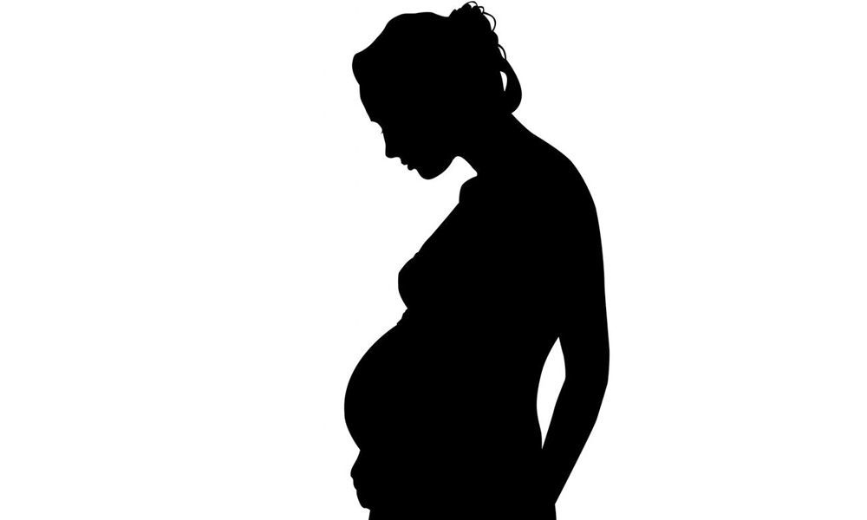
Background
TB remains the leading infectious disease killer, above HIV/AIDS
Pregnancy & postpartum may increase risk of TB
Limited evidence on the risk & burden of TB in pregnancy/postpartum
maternal TB associated with negative outcomes (mortality, unfavourable pregnancy outcomes, infant TB)
unclear risk/benefit trade-off of interventions
IPT during pregnancy/postpartum
Getahun et al. 2012 , Bates et al. 2015, WHO Global TB report 2018, WHO 2018, Gupta et al. 2019,
Notes:
global predominance of TB in men
well documented higher prevalence of HIV in young women
increased risk of TB during pregnancy
Immunological changes associated with pregnancy
opportunity for mycobacterial infection or re-activation
no studies that systematically assessed the direct relationship of pregnancy and the risk of tuberculosis
tuberculosis annually kills more women worldwide than all other causes of maternal mortality combined

Slide 3

Objectives
to perform a rapid review and meta-analysis of the data available in order to quantify the risk of TB during pregnancy and postpartum
to estimate the global and country-level burden of TB disease among pregnant and post-partum women
to estimate the RISK-adjusted global and country-level burden of TB disease among pregnant and post-partum women

Slide 4

Rapid Review & Meta-analysis
Participants/population
Women of child bearing age.
Exposure(s)
Pregnancy; postpartum.
Comparator(s)/control
Non pregnant women.
Outcome
IRR or OR for tuberculosis
PROSPERO 2018,
CRD42018111690

Slide 5

Rapid Review & Meta-analysis
Medline and EMBASE via OVID without date or language restrictions
intersection of terms relating to ‘pregnancy or postpartum’, ‘tuberculosis’, and ‘observational study’
Studies included
longitudinal studies of TB incidence (IRR)
cross-sectional studies of TB prevalence (OR)
cross-sectional studies of the prevalence of pregnancy/postpartum (OR)
NIH’s Quality Assessment Tool for Observational Cohort and Cross-Sectional Studies
Random effects meta-analysis
sub-group analyses
Notes:
In all study types relevant control groups were required for estimation of IRR or ORs

Slide 6

Data abstraction
Study characteristics
First author, year, country, journal of publication, study type, population, exposures, controls
Sample demographics
Age
Sample characteristics
HIV status
Outcome data
Active TB cases, IRR, OR
Notes:
2 independent reviewers

Slide 7

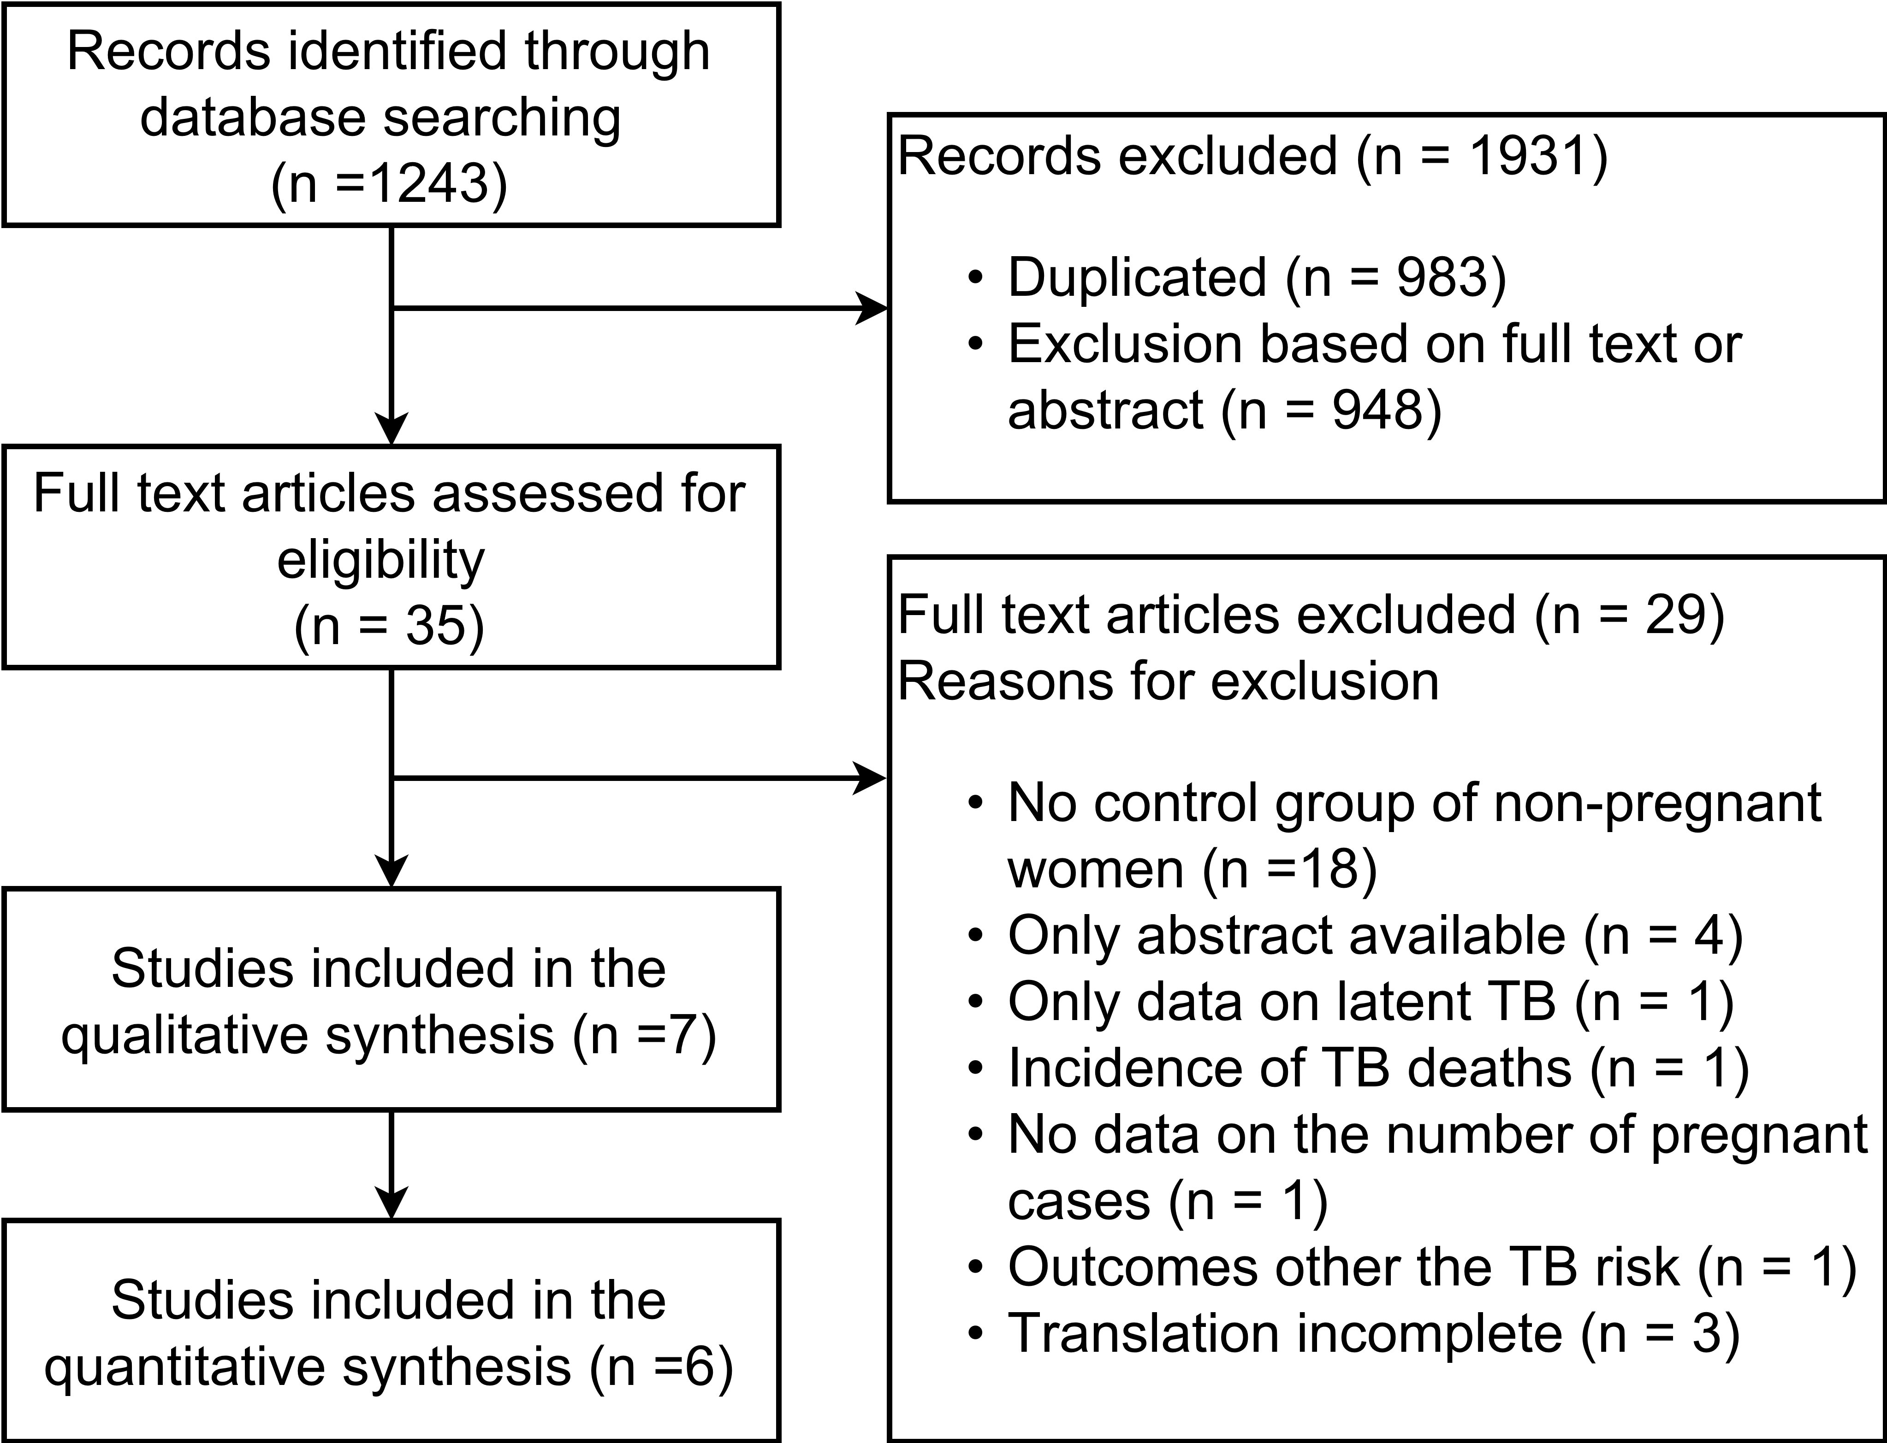
Flow diagram of identification, screening and inclusion of studies

Slide 8

Risk of BIAS assessment
Studies | Study design | Selection | Confounding | Measurement of exposure | Measurement of outcomes | Study-level RoB Judgement
Crampin 2004 | Case control | NoYesNoNo | No | NoNRYesYesNo | NRYesNoNR | High
Bothamley 2016 | Cross-sectional | YesNoNoNo | No | NoNRYesYesNo | NRNRNoNR | High
Espinal 1996 | Case control | YesYesYesNo | No | NoNRYesYesNo | NRYesNoNR | Medium
Odayar 2018 | Retrospective cohort | YesYesYesNo | Yes | YesNRYesYesNo | YesYesNoNR | Low
Rendell 2016 | Retrospective case-control | YesYesYesNo | No | NoNRNoYesNo | NRYesNoNR | Medium
Zenner 2012 | Retrospective cohort | YesYesYesYes | Yes | YesYesYesYesNo | YesYesNoNR | Low
LOW | MEDIUM | HIGH
Notes:
Domain and relevant questions from the NIH tool
Selection – 2,3,4,5
study population clearly specified and defined?
participation rate of eligible persons at least 50%?
subjects selected or recruited from the same or similar populations (including the same time period)? inclusion and exclusion criteria pre-specified and applied uniformly?
sample size justification, power description
Confounding – 14
potential confounding variables measured and adjusted statistically for their impact on the relationship between exposure(s) and outcome(s)?
Measurement of exposure – 6, 7, 8, 9, 10
exposure(s) of interest measured prior to the outcome(s) being measured?
timeframe sufficient to see an association between exposure and outcome?
different levels of the exposure as related to the outcome defined?
exposure measures clearly defined, valid, reliable, and implemented consistently across all study participants?
exposure(s) assessed more than once over time?
Measurement of outcome – 7, 11, 12, 13
timeframe sufficient to see an association between exposure and outcome?
outcome measures clearly defined, valid, reliable, and implemented consistently across all study participants?
outcome assessors blinded to the exposure status of participants?
loss to follow-up after baseline 20% or less?

Slide 9
Risk of TB during pregnancy

Slide 10
Risk of TB during postpartum

Slide 11

Estimating the burden of TB disease among pregnant and post-partum women

Slide 12

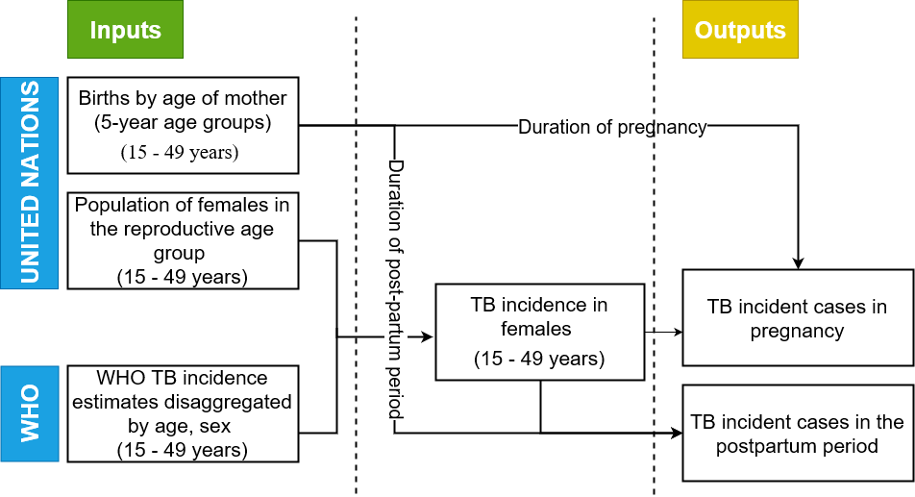
Burden estimation approach

Slide 13

Total number of active tuberculosis cases
WHO Region | Pregnancy | Postpartum
 | Mean (95% uncertainty range) | Mean (95% uncertainty range)
All countries combined | 150 600 (119 800, 181 300) | 49 000(39 000, 59 000)
AFR | 60 900 (48 300, 73 400) | 19 000 (15 700, 23 900)
AMR | 3 000 (2 500, 3 500) | 1000 (800 , 1 100)
EMR | 16 300 (9 000, 23 500) | 5 300 (2 900, 7 700)
EUR | 2 800 (2 100, 3 500) | 900 (700, 1 100)
SEA | 54 300 (27 700, 81 000) | 17 700 (9 000, 26 400)
WPR | 13 300 (8 500, 18 200) | 4 300 (2 800, 5 900)

Slide 14
Estimated burden across WHO regions
Notes:
10.42

Slide 15
Global burden of TB disease during pregnancy

Slide 16
Global burden of TB disease during postpartum

Slide 17
Summary
The burden of TB during pregnancy and postpartum is substantial
Evidence on the risk of TB during pregnancy & postpartum is still uncertain
limited amount/quality of studies
Further work required to improve estimates
including IRR & HIV in the burden estimation
TB pregnancy registries
Required for informing practical decisions on policy
Notes:
Burden may well be under-estimated – substantial in light of adverse outcomes and potential impact on practical decisions on policies

Slide 18




Acknowledgements

Slide 19
Reserve slides

Slide 20

Burden of TB during pregnancy
sparse data regarding TB during pregnancy and postpartum
prevalence
review of available data
0.06% to 0.25% in low-burden countries
0.07% to 0.5% HIV-negative women in high-burden countries
0.7% to 11% HIV-positive women in high-burden countries
epidemiological modelling study
210 per 100,000 pregnant women globally in 2011 (95% CI 180–240)
Odayar et al. 2018, Sugarman et al. 2014, Mathad & Gupta 2012

Slide 21
First author, year | Study years | Country | Population, setting | Study type | Control type | HIV status | Mean age and SD/range | TB case definition | Postpartum definition | Quality assessment
Bothamley, 2016 | 2008-2013 | Europe and the USA | All patients with TB seen at 13 different clinics | Cross sectional survey | None given | No data given | No data given | No data given | 3 months | Poor
Crampin, 2004 | 1996-2001 | Malawi | TB patients of both genders identified via “enhanced passive surveillance” | Case control | Field based random sampling of the community | Cases: 32%- 68%+ Control: 86%- 14%+ | No data given | Positive smear, culture or biopsy | 6 months | Poor
Espinal, 1996 | 1992-1994 | Dominican Republic | Women aged 15-44 with newly diagnosed active TB seen at 4 different facilities | Case control | Recruited at the National Laboratory of Public Health when they presented for anon HIV testing | No data given | No data given | Must have all of: typical signs and symptoms of TB, >1 smear of resp tract secretions + for AFB, no history of prior TB | NA | Fair
Odayar, 2018 | 2013-2014 | South Africa | Women at a large public sector primary health care facility, HIV+ women during pregnancy or postpartum | Retrospective cohort study | None given | All + | 29 at enrolment IQR 26-33 | Positive sputum smear microscopy, TB culture, CXR abnormalities consistent with TB | 6 months | Good
Rendell, 2016 | 2013 | Mongolia | Data collected on pregnant women diagnosed from TB from central TB dispensaries | Retrospective case study | None given | <0.1% + | Pregnant women with TB: 27 (SD +/- 5.6, range 18-43) | Based on microbiological results or symptoms and CXR findings | NA | Fair
Zenner, 2012 | 1996-2008 | United Kingdom | All women with pregnancies that occur within the time period studies | Cohort study | Self-controlled case series | No data given | At pregnancy: 29.5 (range 13-50) | Positive sputum culture, presence of clinical/radiological signs, symptoms | 6 months | Good
Title goes here

Slide 22
Risk of BIAS assessment
Studies | Study design | Selection | Comparability | Exposure/ Outcome | Study-level RoB Judgement
Crampin 2004 | Case control | **** | * | *** | High
Bothamley 2016 | Cross-sectional | * |  | * | High
Espinal 1996 | Case control | **** |  | ** | Medium
Odayar 2018 | Retrospective cohort | **** | ** | *** | Low
Rendell 2016 | Retrospective case-control | **** |  | *** | Medium
Zenner 2012 | Retrospective cohort | **** | ** | *** | Low
****/**/**** | **/*/** | *//*
Notes:
Domain and relevant questions from the NIH tool
Selection – 2,3,4,5
study population clearly specified and defined?
participation rate of eligible persons at least 50%?
subjects selected or recruited from the same or similar populations (including the same time period)? inclusion and exclusion criteria pre-specified and applied uniformly?
sample size justification, power description
Confounding – 14
potential confounding variables measured and adjusted statistically for their impact on the relationship between exposure(s) and outcome(s)?
Measurement of exposure – 6, 7, 8, 9, 10
exposure(s) of interest measured prior to the outcome(s) being measured?
timeframe sufficient to see an association between exposure and outcome?
different levels of the exposure as related to the outcome defined?
exposure measures clearly defined, valid, reliable, and implemented consistently across all study participants?
exposure(s) assessed more than once over time?
Measurement of outcome – 7, 11, 12, 13
timeframe sufficient to see an association between exposure and outcome?
outcome measures clearly defined, valid, reliable, and implemented consistently across all study participants?
outcome assessors blinded to the exposure status of participants?
loss to follow-up after baseline 20% or less?

Slide 23
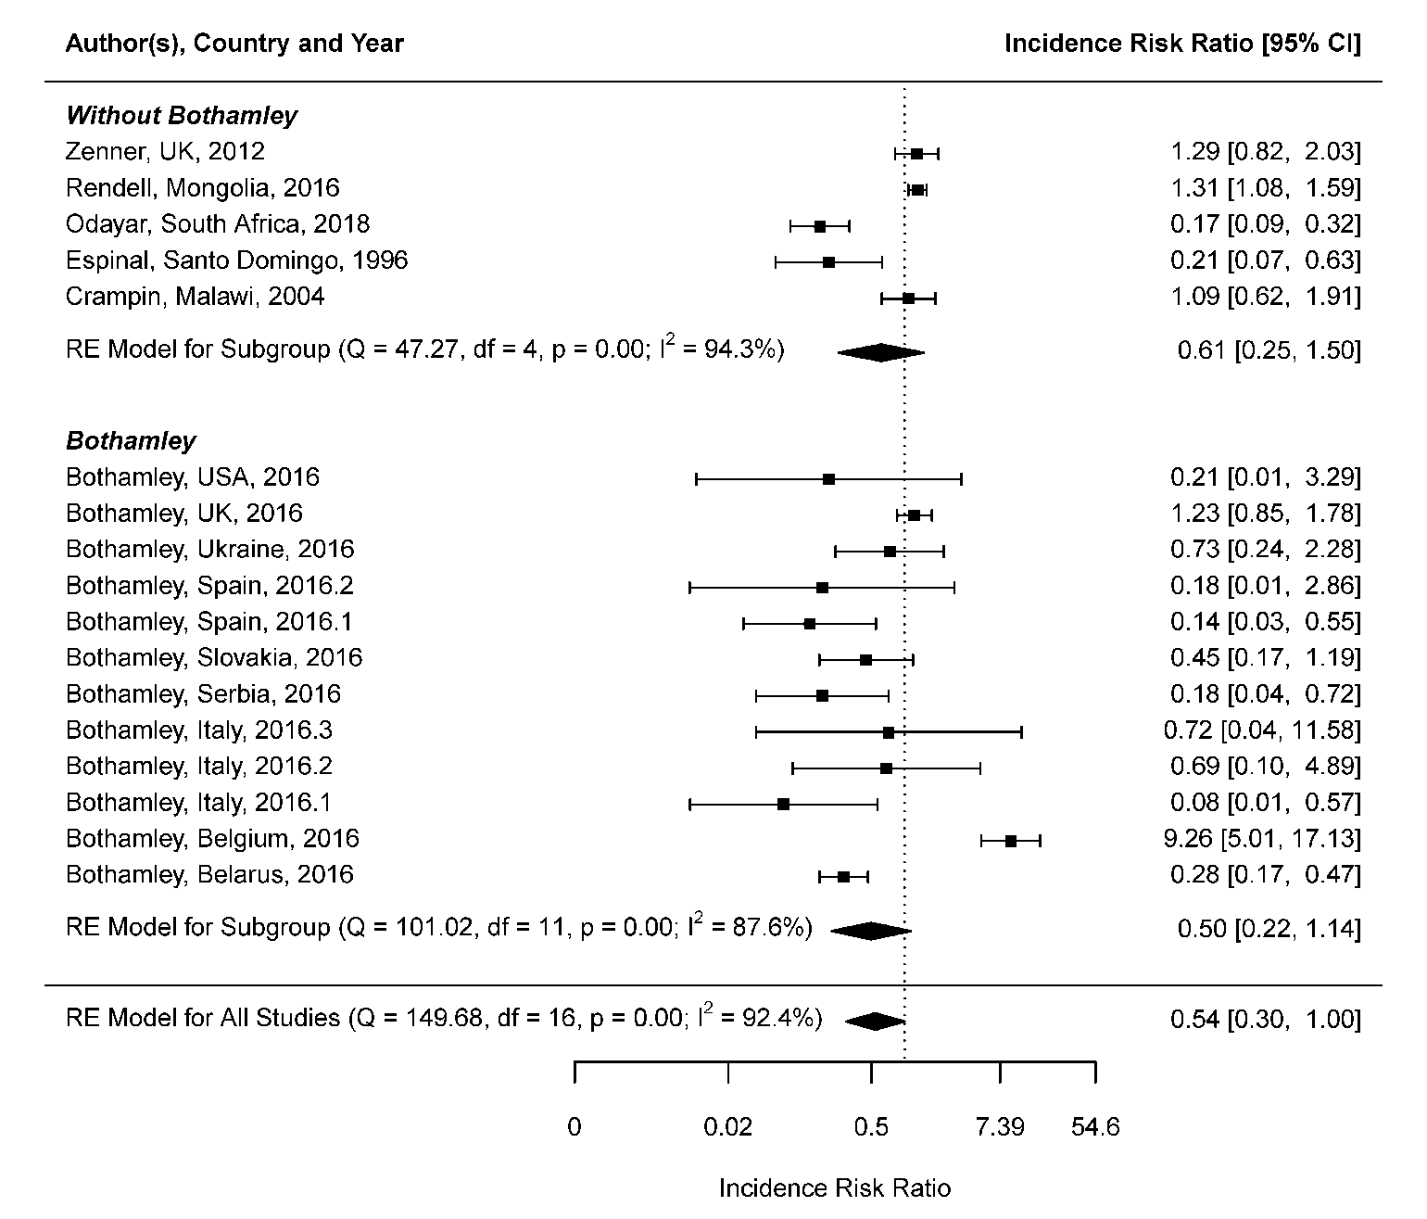
Risk of TB during pregnancy

Slide 24
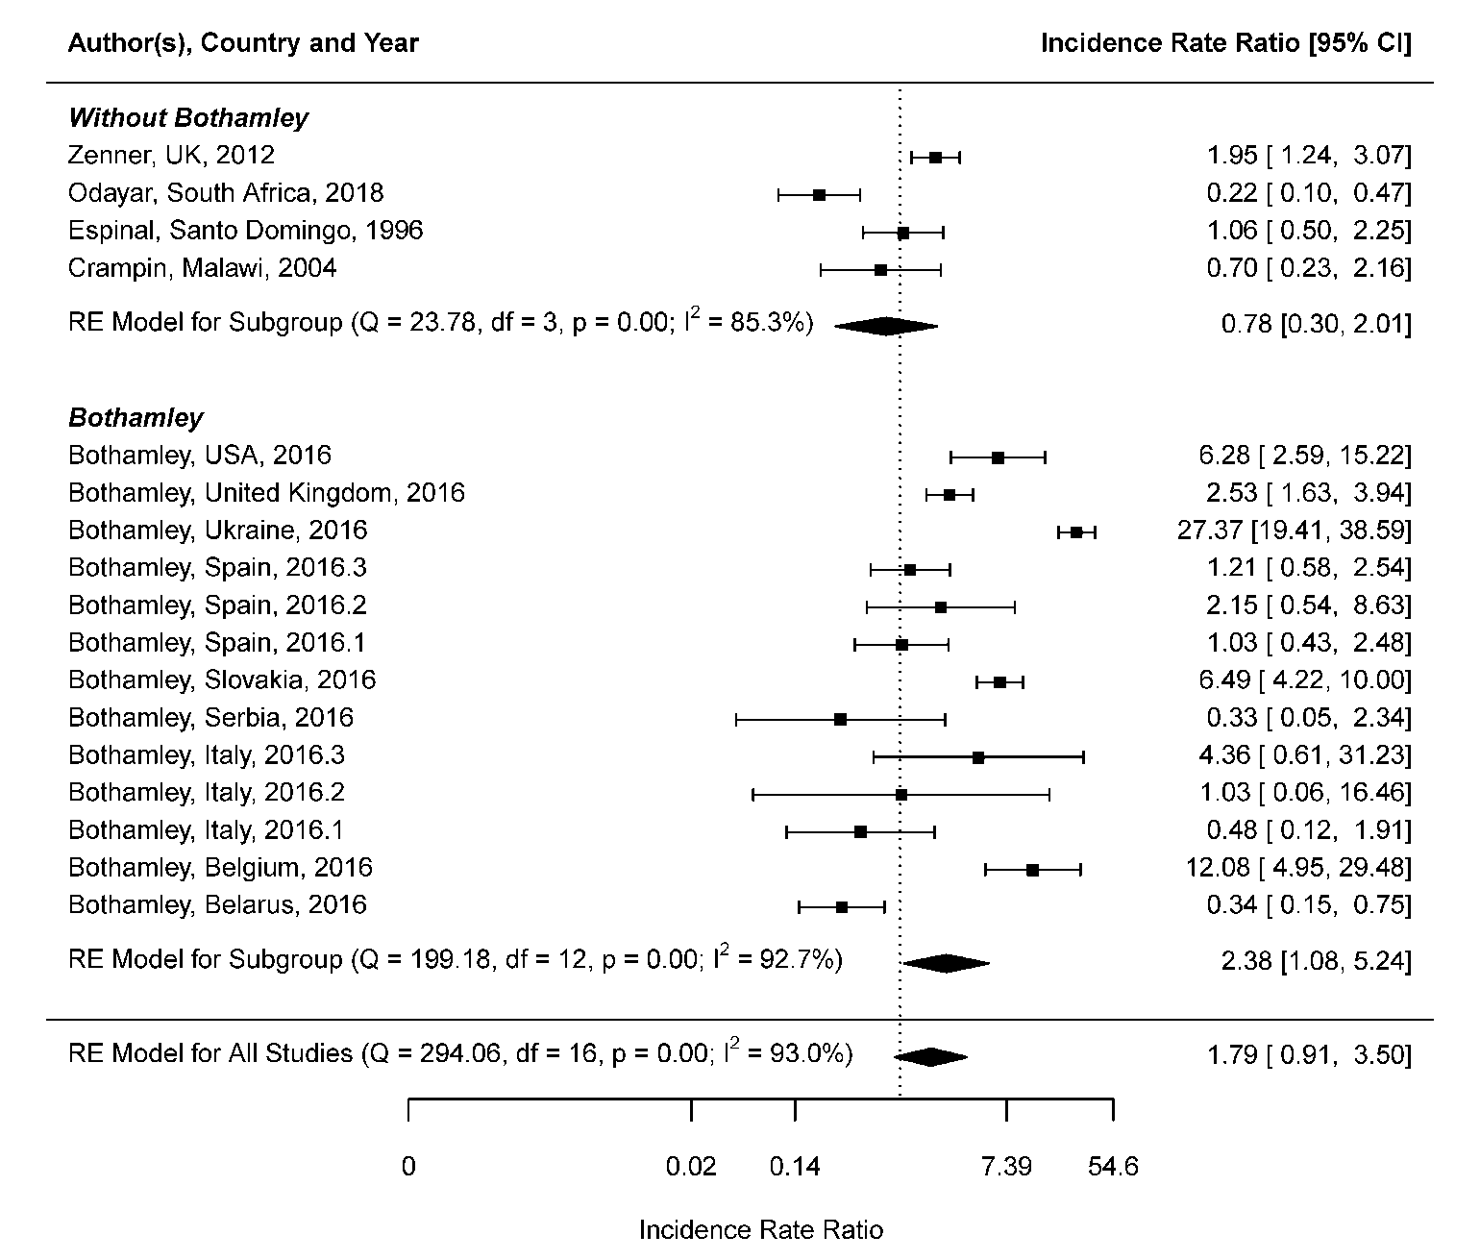
Risk of TB during postpartum

